Slide 1
Lab 5: Sketching Interactions
Arthur Bell Cameron Giddens
Alex Greenough Alex Mossman
Alec Whitticase Yang Zhang

Slide 2
10 (multi-step, annotated) sketches showing:
5 different designs for establishing a connection between devices.
5 different designs for selecting and sharing photos.

Slide 3
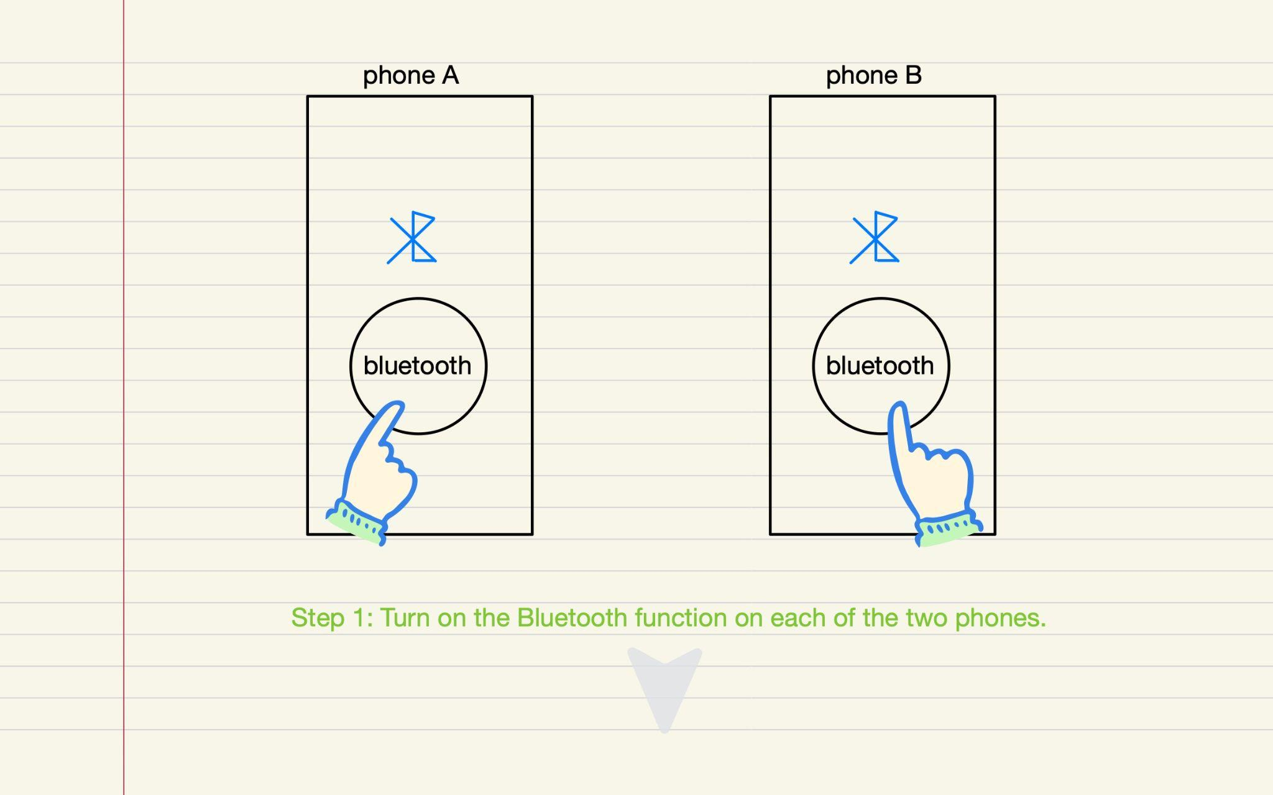

Design 1: Establishing Connection - Bluetooth Pairing

Slide 4
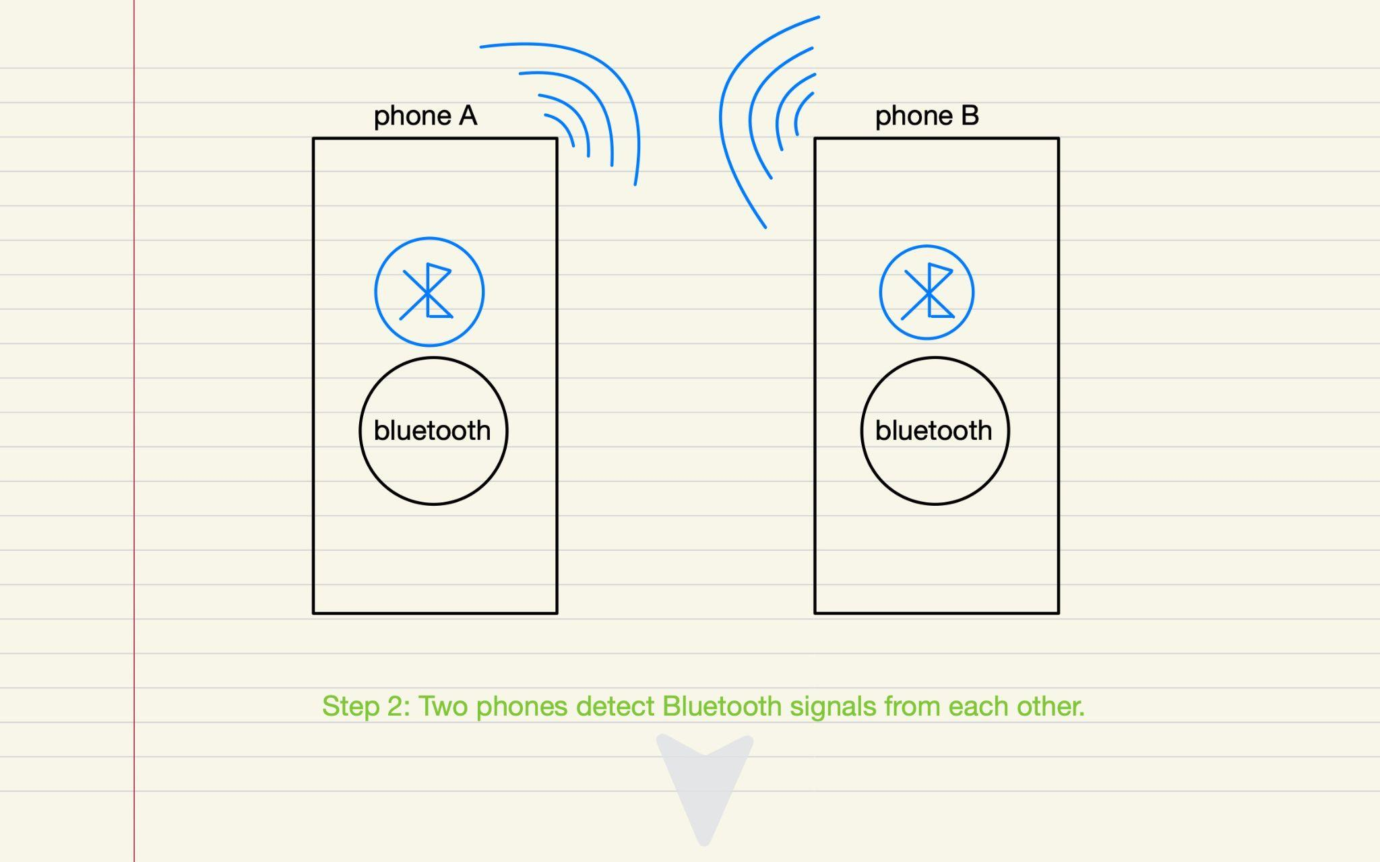
Design 1: Establishing Connection - Bluetooth Pairing

Slide 5
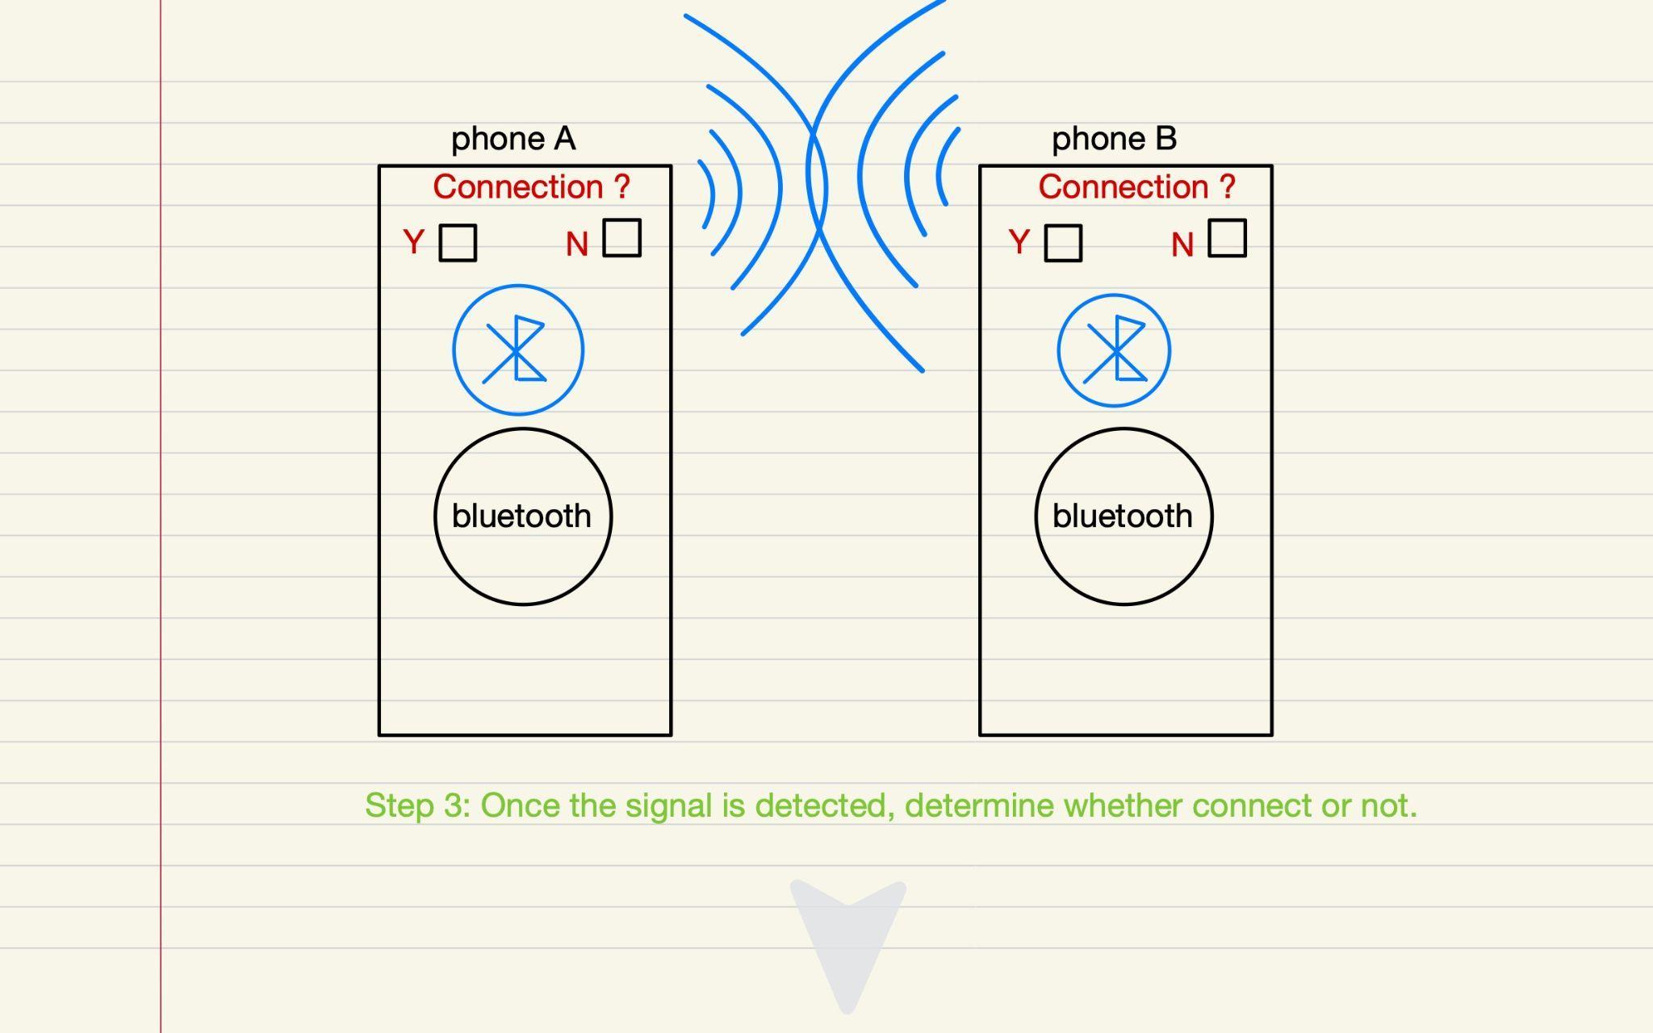
Design 1: Establishing Connection - Bluetooth Pairing

Slide 6
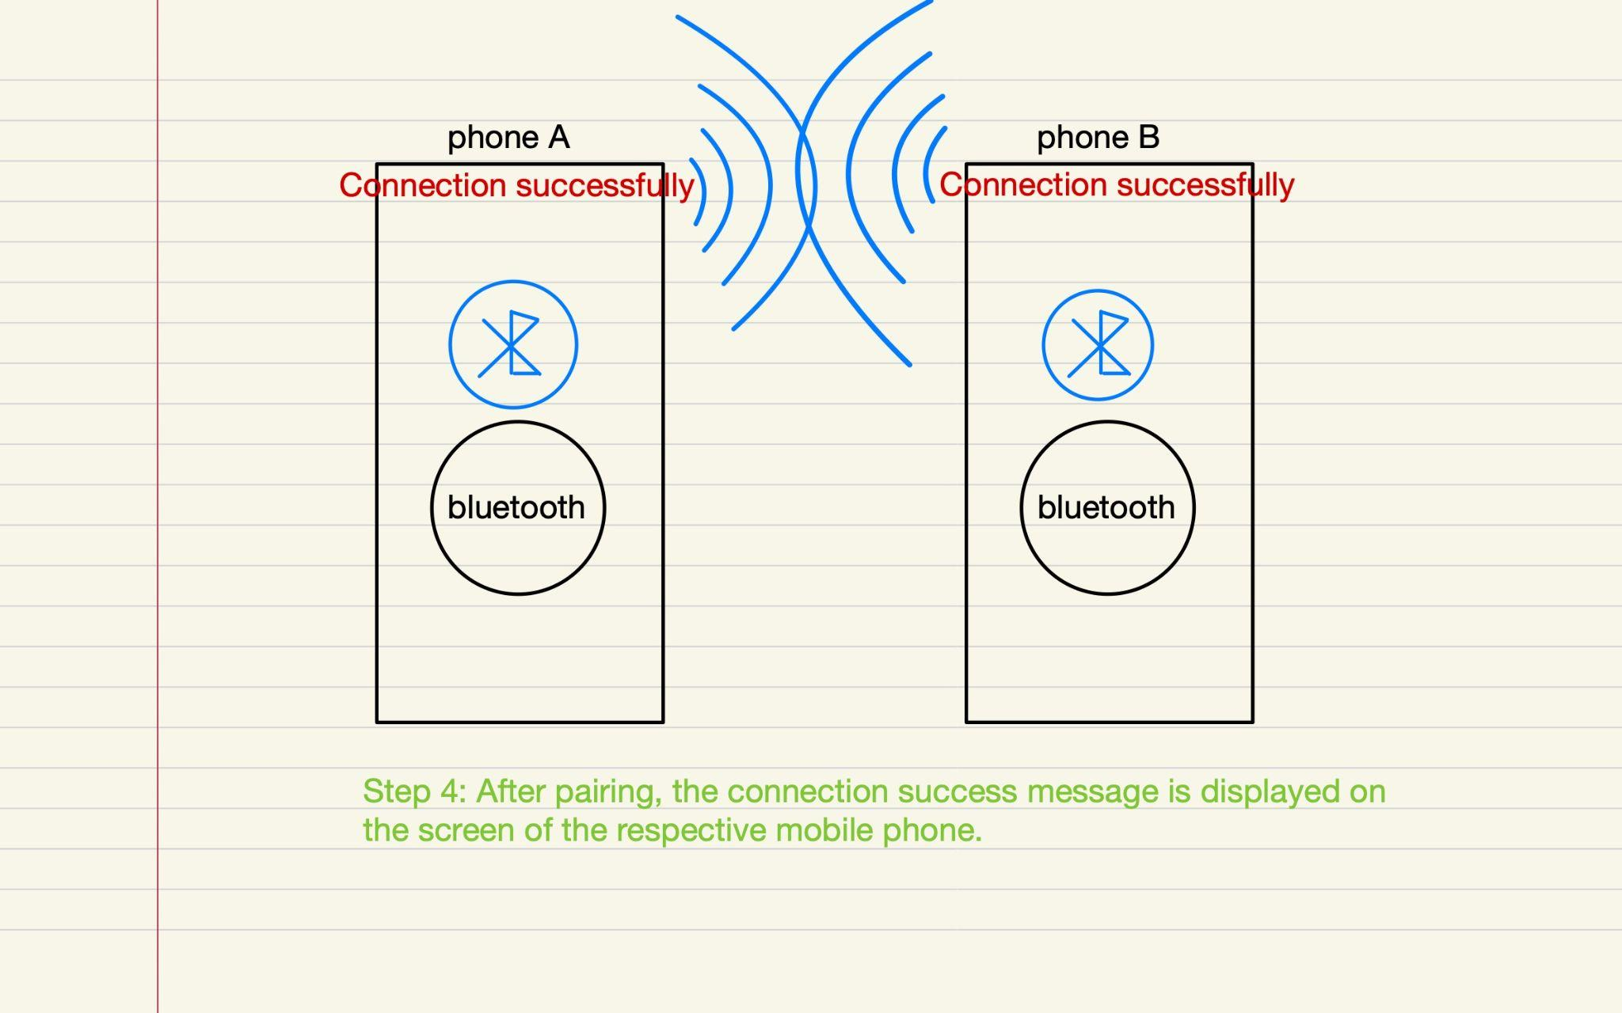
Design 1: Establishing Connection - Bluetooth Pairing
Strengths: Simple and familiar process. Weaknesses: Bluetooth pairing might take time and could be unreliable.

Slide 7
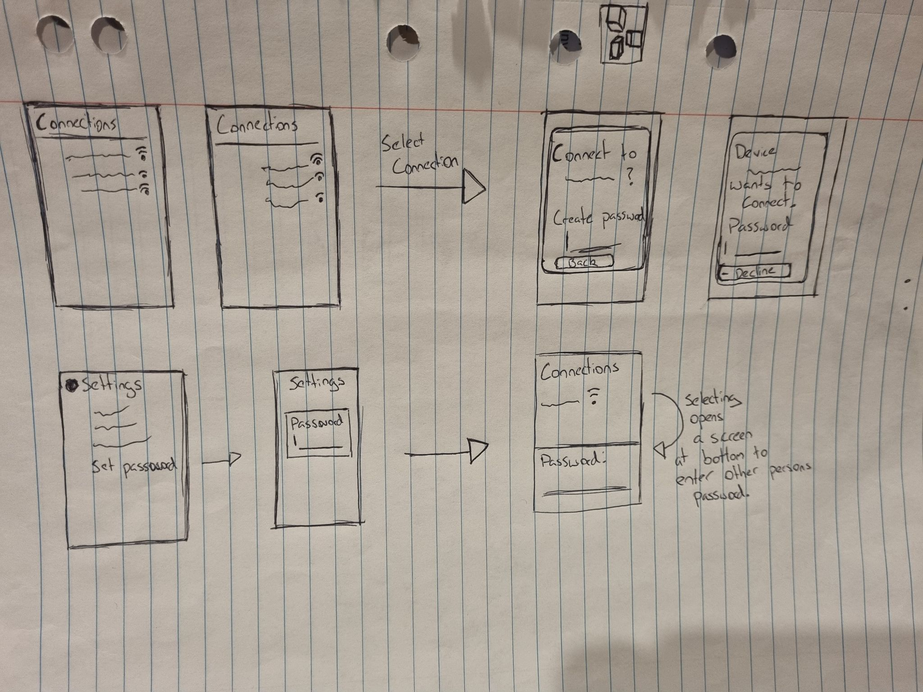
Design 2: Establishing Connection -
Basic design, uses a password to ensure that only desired devices are connected. Opens in a new window over top.
Pros: simple, easy to implement.
Small number of steps to establish connection.
Cons: New window obscures info that might be required. Password setting and communicating takes time and is more complicated.
Having both people enter a password seems like more effort than should be required.

Slide 8

Design 3: Establishing Connection -
The same as the basic design except it opens the options at the bottom, instead of a different window.
Pros:
This takes away the weakness of blocking screen.
Setting the password in settings means you don’t have to create a new one every time.
Cons:
Having the password at the bottom of the screen is further away from the focal point so could make it harder for the user to use.

Slide 9
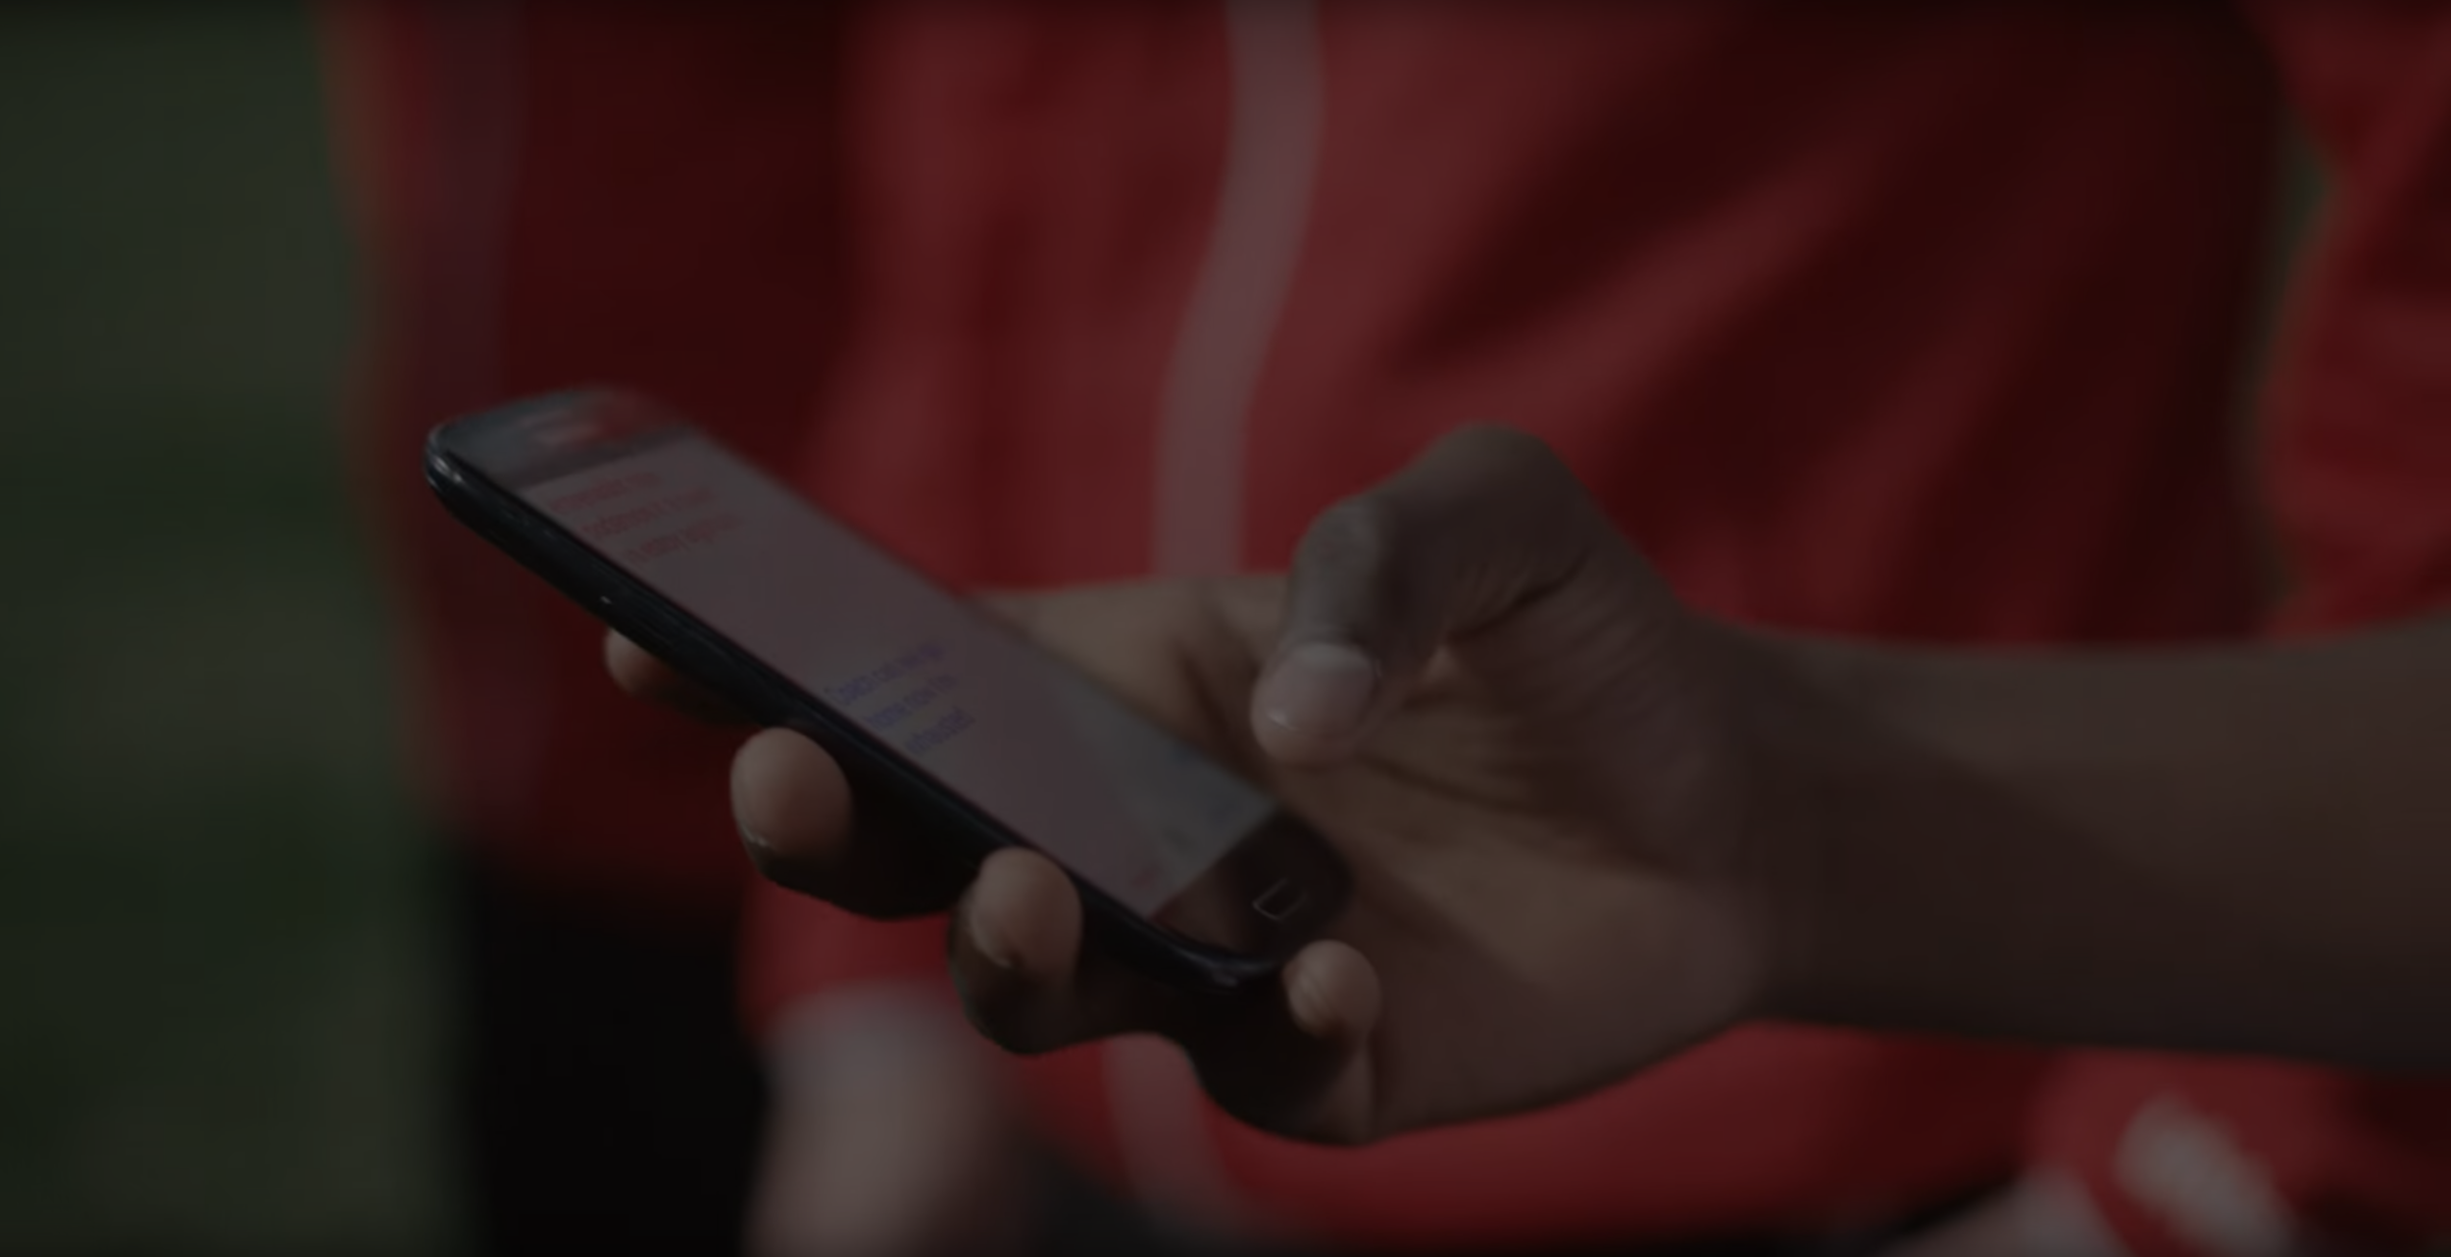
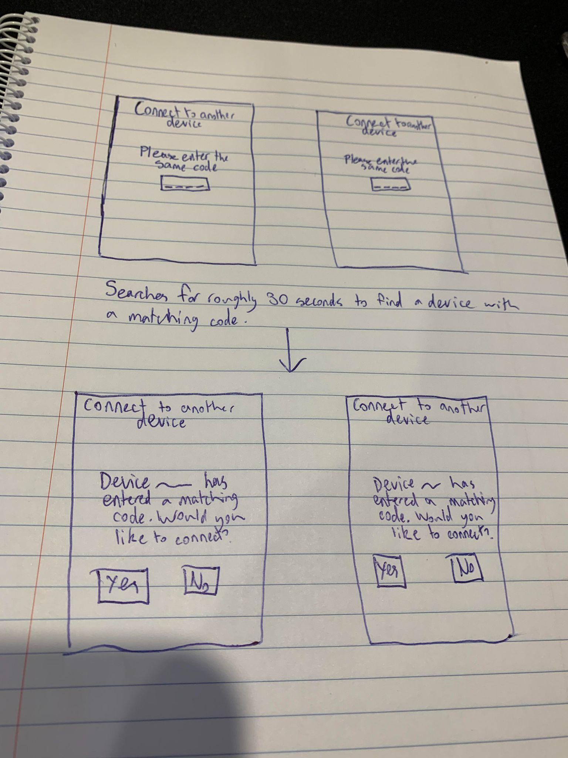
Design 4: Establishing Connection -
Strengths: Low chance of connecting with the wrong device, Low chance of human error
Weaknesses: Slightly more tedious than other designs

Slide 10
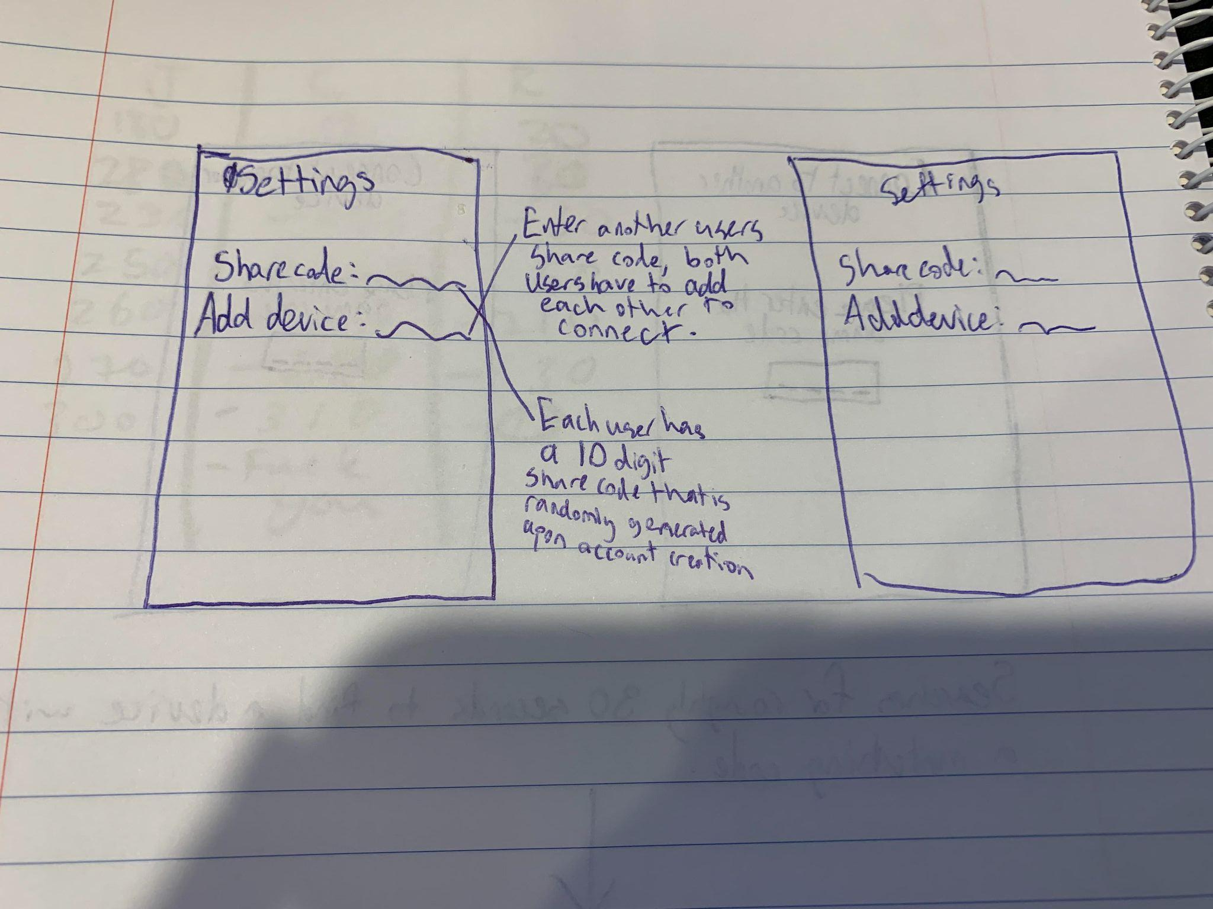
Design 5: Establishing Connection
Strengths: Extremely difficult to match with wrong device
Weaknesses: Very tedious, if user’s account is compromised other devices can connect using the share code

Slide 11
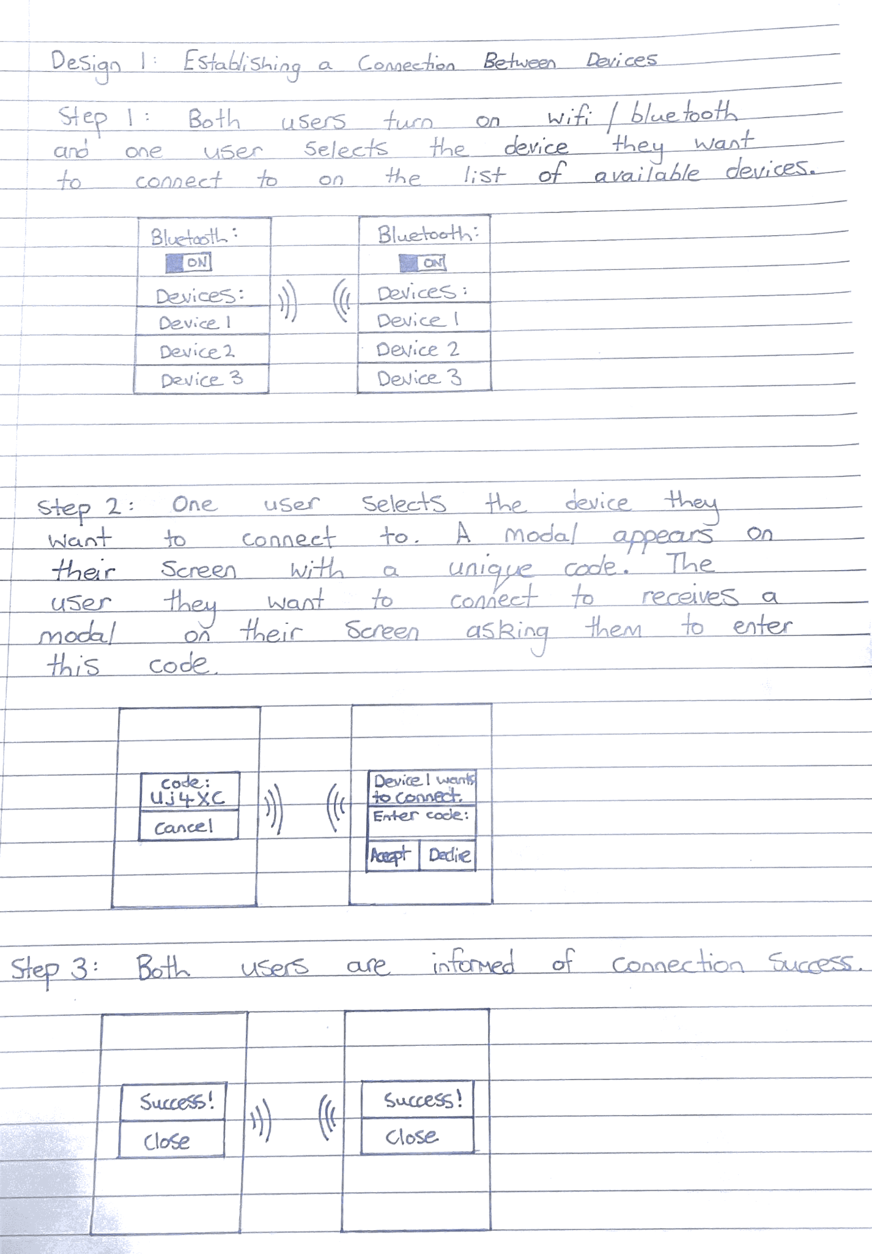
Design 6: Establishing Connection
Pros:
Protects against wrongful or unwanted connections as the user must enter the correct code each time
More secure than a password as the code is randomly generated for each connection
Cons:
More tedious for the users as two way communication is required each time they want to establish a connection, and the code changes each time

Slide 12

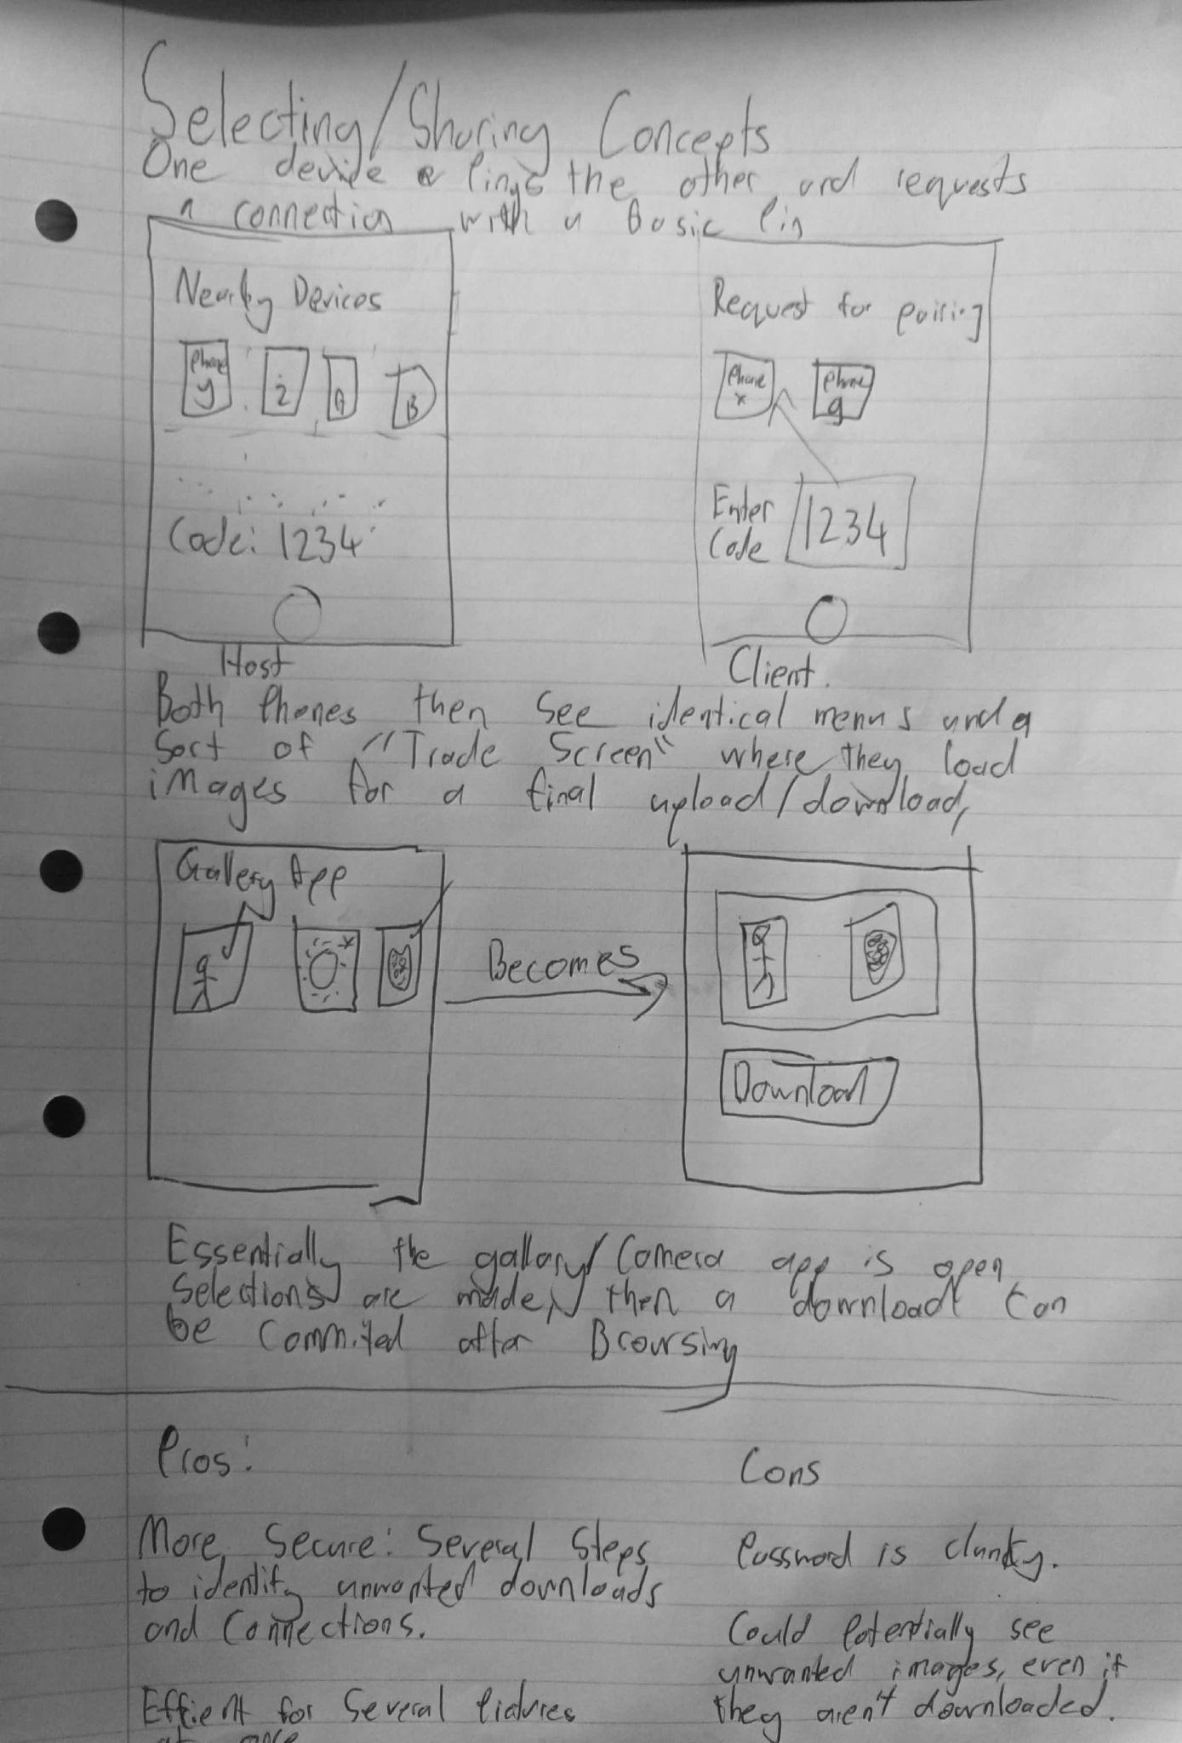
Design 7: Photo Selection - Drag and Drop
Host and client connect, a pin is used to ensure the correct bluetooth connection. A folder is created on the host side that the client previews and can then choose to download.
The main idea here was to create a design that gave users plenty of time to see errors in the transfer and make sure no unwanted content was downloaded.

Slide 13
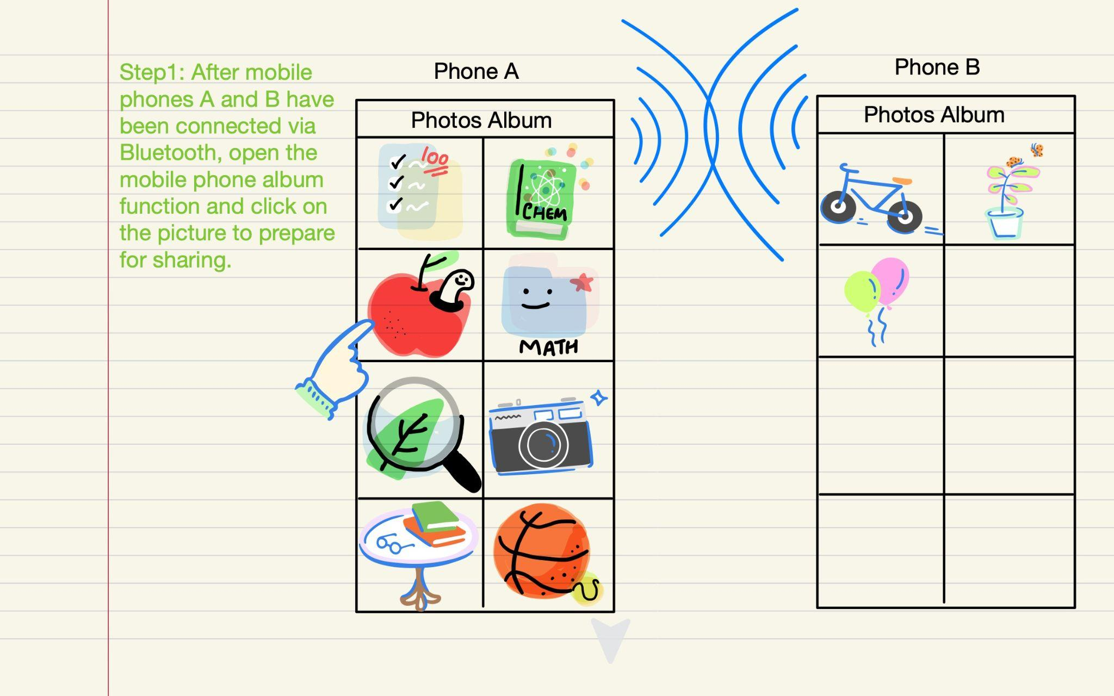
Design 8: Photo Selection - Drag and Drop

Slide 14
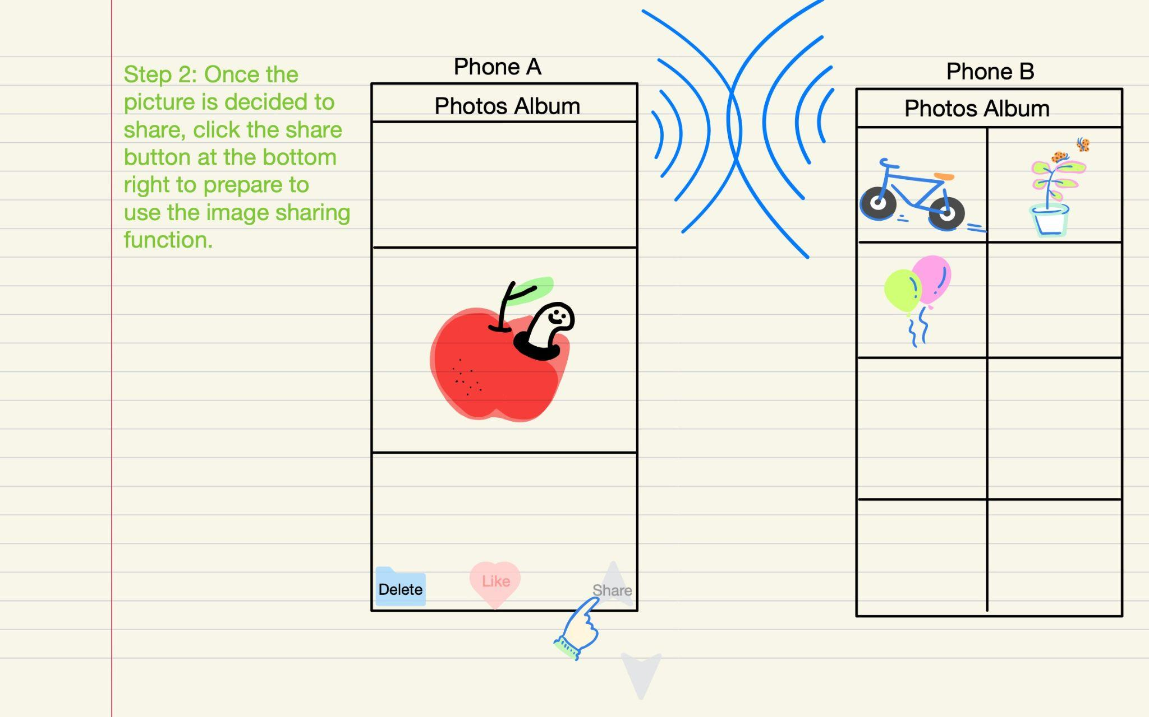
Design 8: Photo Selection - Drag and Drop

Slide 15
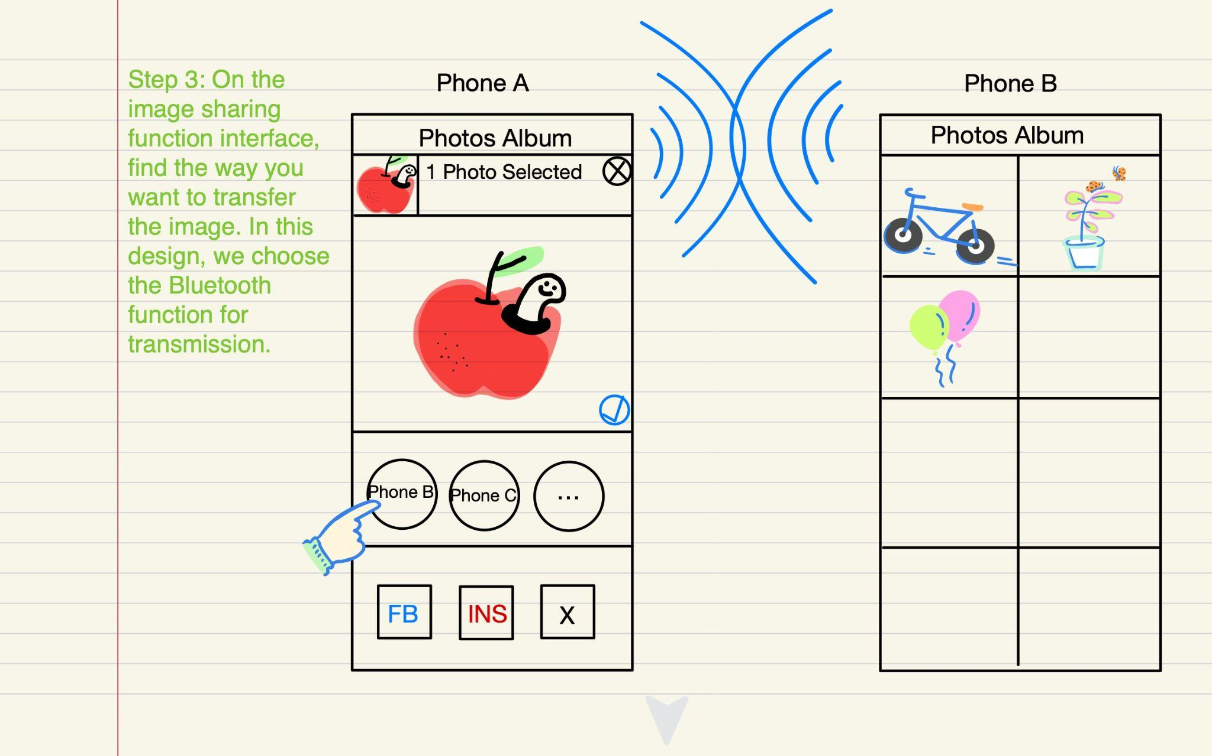
Design 8: Photo Selection - Drag and Drop

Slide 16
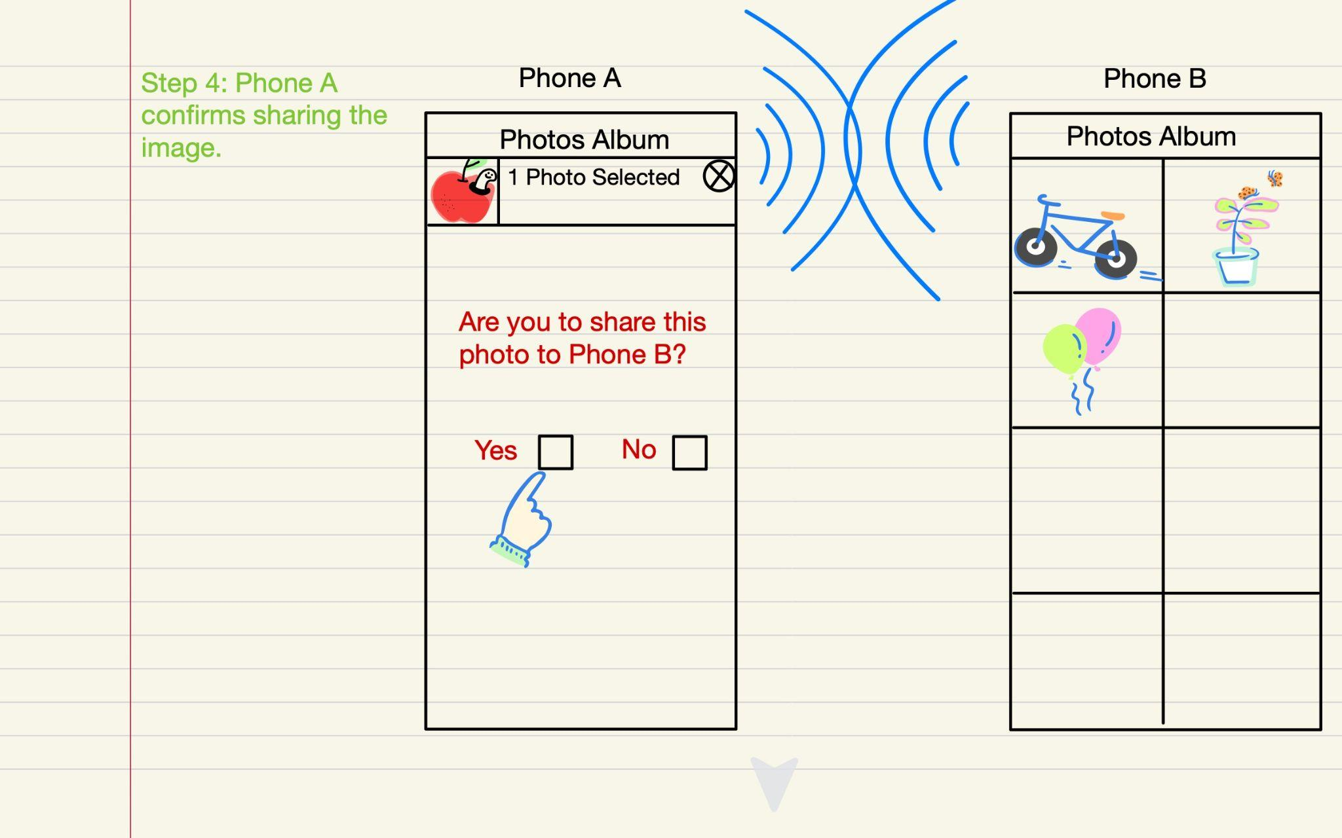
Design 8: Photo Selection - Drag and Drop

Slide 17
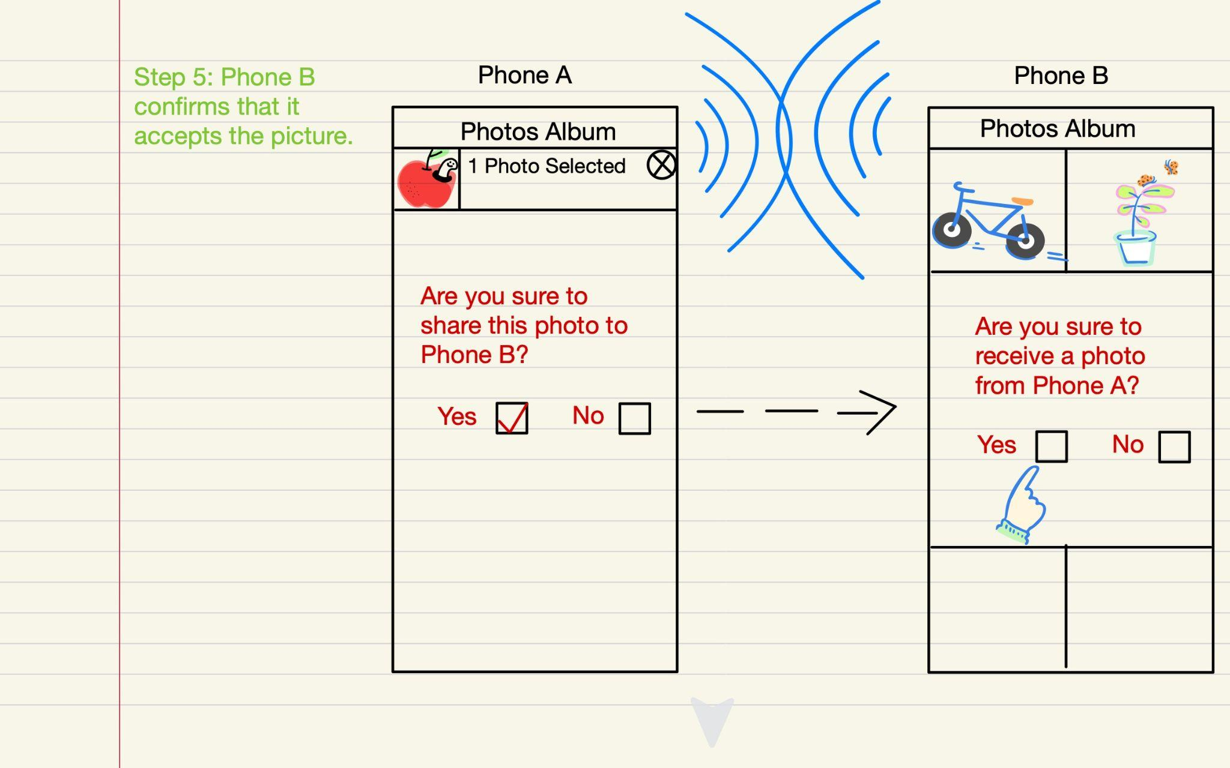
Design 8: Photo Selection - Drag and Drop

Slide 18
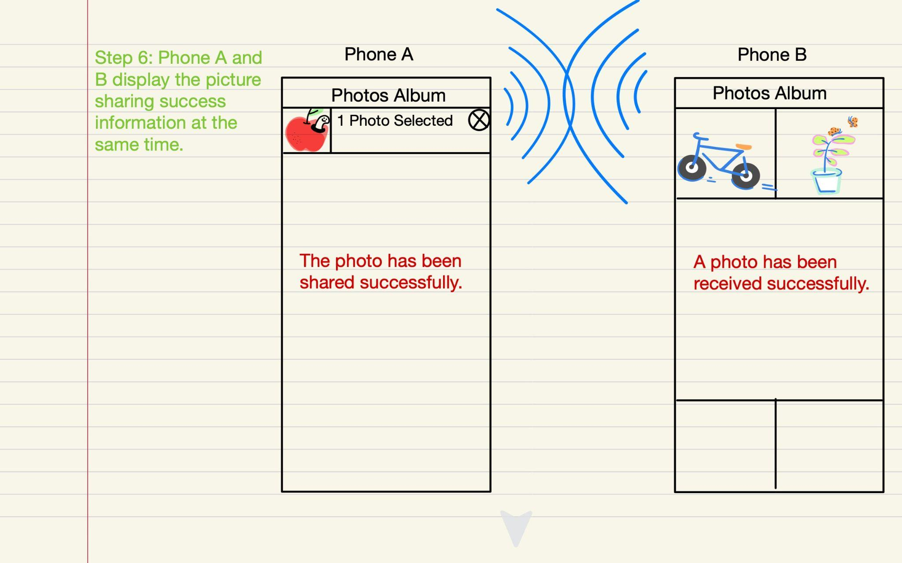
Design 8: Photo Selection - Drag and Drop

Slide 19
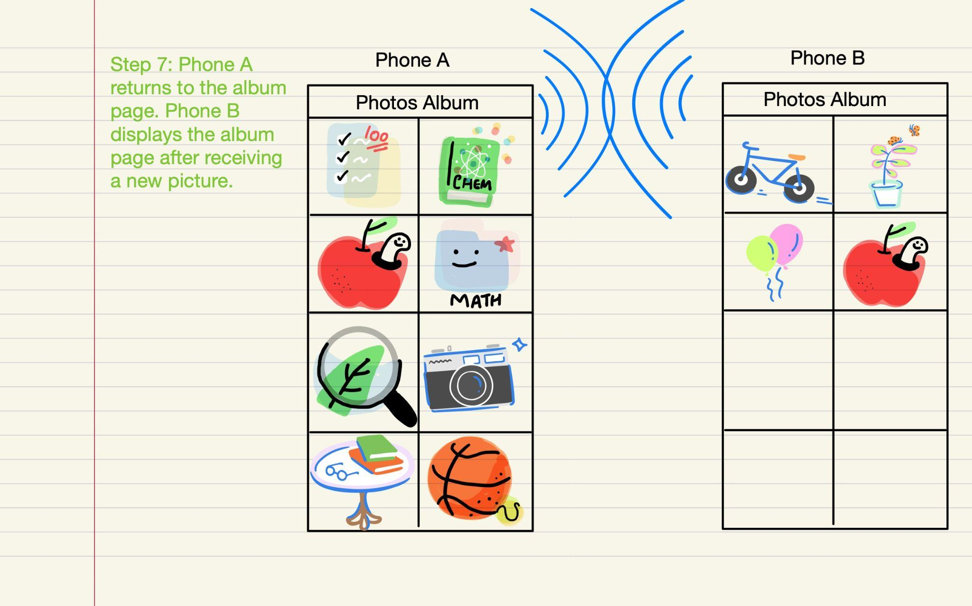
Design 8: Photo Selection - Drag and Drop
Advantages: This method is intuitive and reliable, and is efficient and convenient for users with familiar with the user interface.
Disadvantages: For new users who are not familiar with the operation interface, it takes more time to learn.

Slide 20
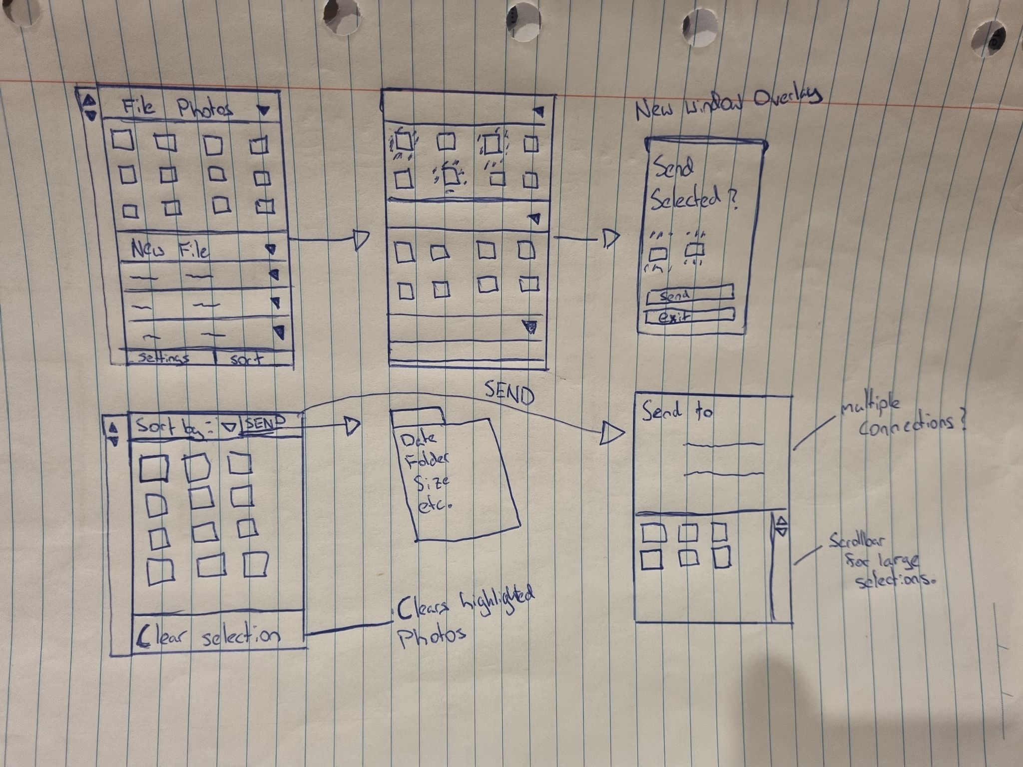
Design 9: Photo Selection - Drag and Drop
Pros:
Photos are organised by folder.
Finding photos in a large collection is easier with ability to hide groups.
Selecting large groups of photos is easier.
Cons:
Lots on the screen at once.
Extra settings to set takes more time and may be confusing.

Slide 21
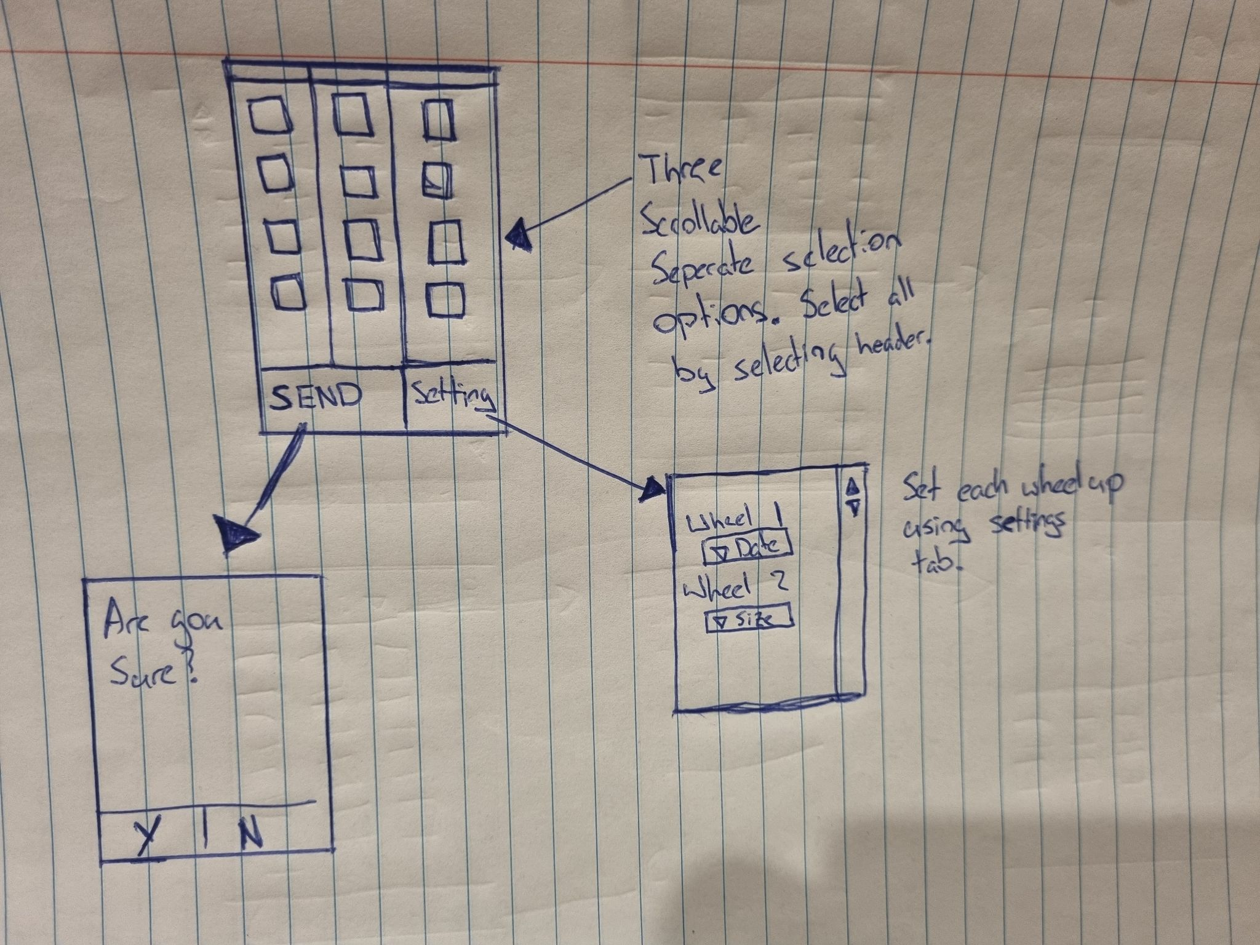
Design 10: Photo Selection - Drag and Drop
Pros:
Less settings than previous design.
Allows for quick selection from multiple places.
Cons:
Not that intuitive, doesn’t really mimic any other design that might be known by a user.
Doesn’t allow for large selections from one category easily.

Slide 22
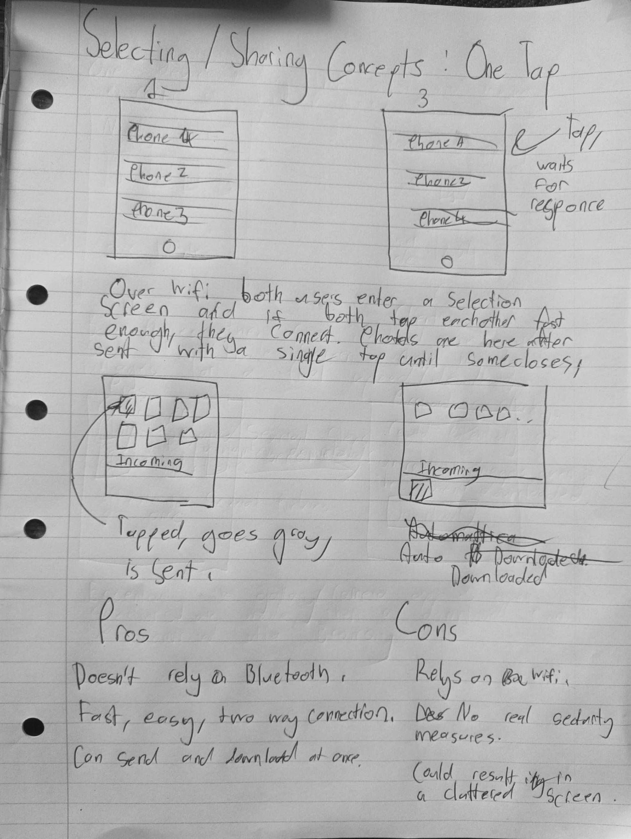
Design 11: Photo Selection - Drag and Drop
A two way connection is set up over wifi, then a screen appears with both each users gallery and an incoming photos bar. Here, each user can send a photo by a single tap on a given photo.
The main intent of this design was to create minimal barriers and minimise the time sending photos would take over any other concerns.

Slide 23
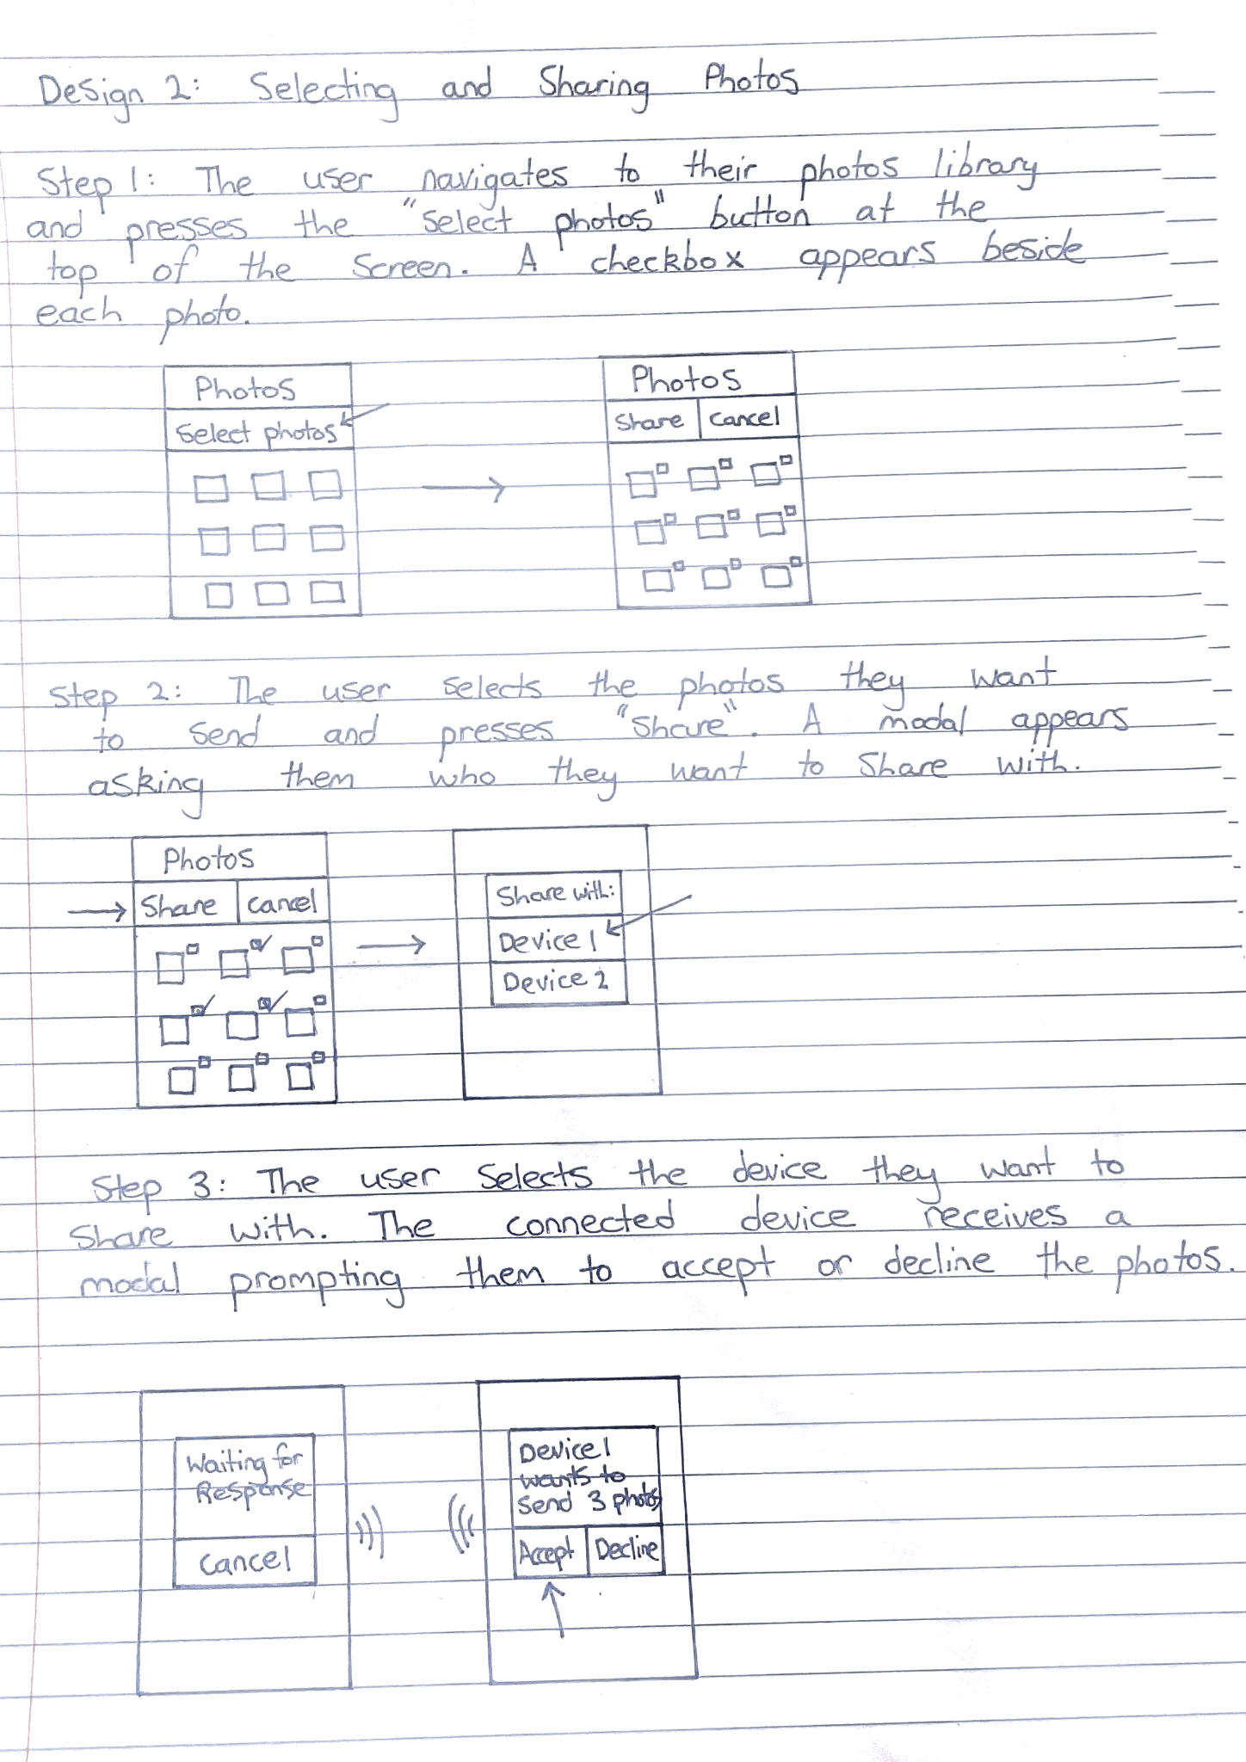
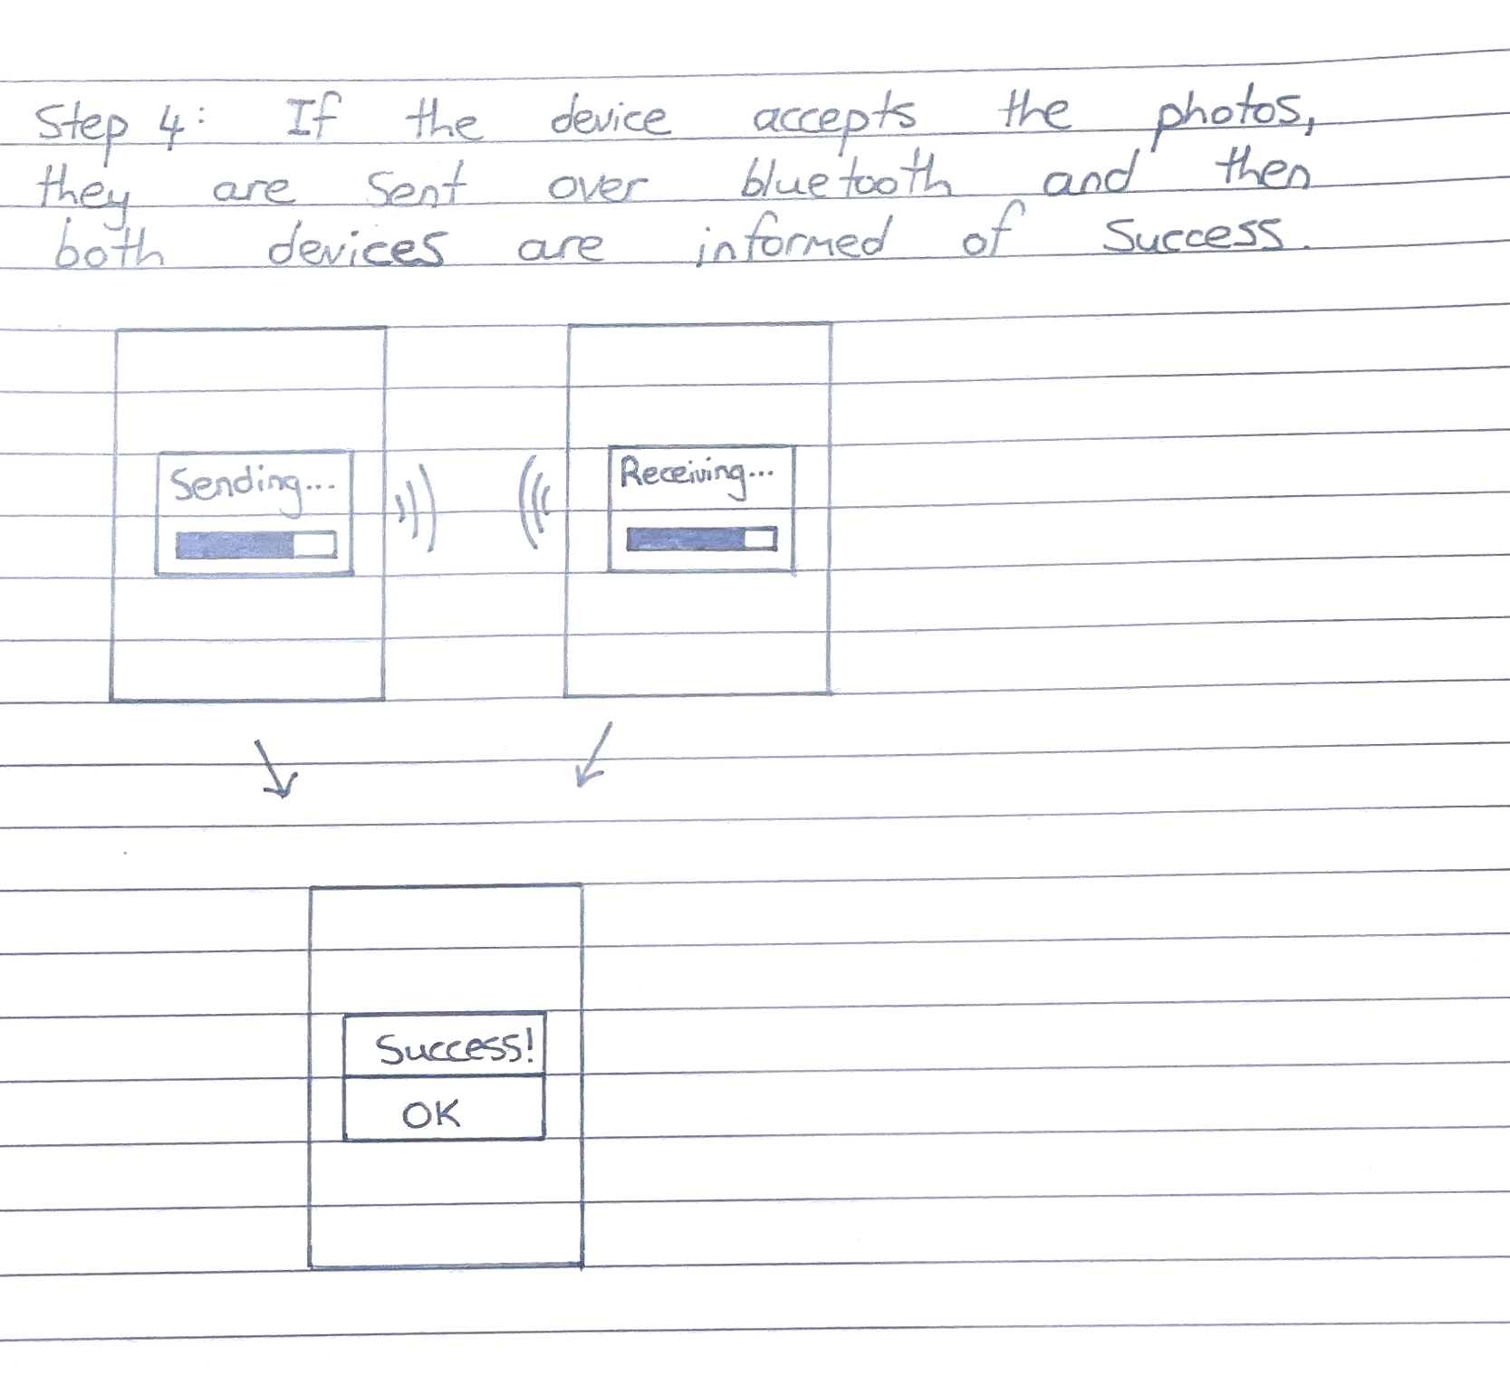
Design 12: Photo Selection

Slide 24
Design 12: Photo Selection
Pros:
Easier than a drag and drop design for selecting a large amount of photos at once
Less time is needed to select photos, compared to dragging and dropping
The receiver is able to preview the photos before downloading them, which saves bandwidth and prevents the receiver from downloading unwanted content
Cons:
Less intuitive than drag and drop
More steps required compared to other designs

Slide 25
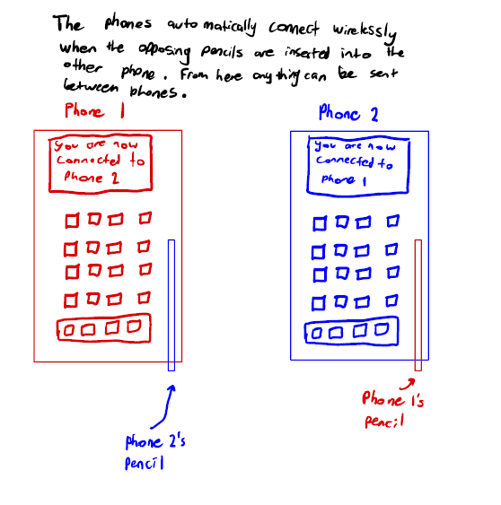
Design 13 - Connecting
Pros: The connection is simple and doesn't require any prompts or button presses on screen. Using a physical object (the pencil) as a “key” ensures the pairing is thought about and therefore also doesn't need a password.
Cons: If the pencil for a phone is lost, pairing is not possible. The people paring must also be physically with each other.

Slide 26
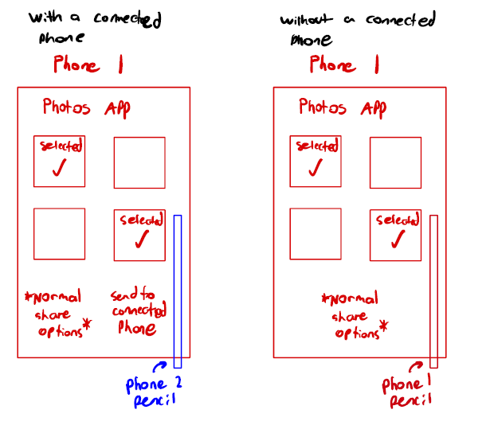
Design 14 - Photo Sharing
Pros: The sharing is simple to use as once a phone is paired the photos can be selected like normal in the photos app and while connected to another phone the users phone simply has a new “unlocked” button which lets them send to the paired phone.
Cons: The paired phone may no longer want to receive anymore photos but while the pencils are inserted into the opposing phones they can freely send photos.
A solution to this could be to remove the other phones pencil to cancel the connection.

Slide 27
Final Design:
Connections:
Select device to connect
Connections:
Phone:
Phone:
Desired device:
Desired device:
Bottom screen opens up and password prompt is given
Connected!
Password: _____________
Settings
Share
Settings
Share
Click share to open photo sharing screen

Slide 28

After pressing the share photos button on the previous screen, their photo library appears
User presses select button
Photos:
Select
Cancel
Checkboxes appear next to photos
Device 1 wants to send 3 photos:
Receiving device sees a modal appear with photo thumbnails
Accept
Decline
User presses accept button
User presses send button after selecting photos
Send

Slide 29
Both users are informed of success
Sending..
Receiving…
Success!
Once the user accepts the photos a progress bar is visible on both devices as the photos are sent

